Slide 1

Technology Hackathon 2025
STAT
Gen AI - Integrated Platform Support
Team: WelsV
March 26th 2025

Slide 2

Problem Statement
Develop a Gen AI enabled integrated Platform Environment that provides an integrated console to our platform support teams providing them AI chatbot capabilities
The Capabilities such as agentic capabilities for Incident resolution, AI chatbot and contextual recommendation which can leverage the enterprise information for trouble shooting.
Integrated platform environment should be one-stop environment for all platform support users/teams for identifying, resolving and responding to all incidents
STAT

Slide 3
What’s the Solution ?
AI/ML based solution using sentence-transformer Model
Sentence-Transformers simplifies the process of converting sentences into embeddings.
Sentence-transformer (MiniLM-L6-v2 Model) that is great for tasks like
Semantic search
Clustering
Identifying sentence similarity
MiniLM-L6-v2 NLP is used to train the Model with the ticket information and create embeddings, It takes a sentence or a short paragraph and maps it to a 384-dimensional vector
Python is used to integrate to Model
Utilize ChatGPT Gradio to generate UI
Tech Stack
Gradio
ChatGPT
MiniLM-L6-v2" Model
Hugging Face Sentence Transformer
Python

Slide 4
Design Approach
Life Cycle of AI search – Integrated Platform Environment
7. Deployment
1. Data Gathering
The last step in ML life cycle is deployment, where we deploy the model in the live system
Data Gathering is first step of Machine Learning life cycle, the goal is to identify and obtain all data related problems
2. Data Preparation
6. Test Model
After collecting the data, we need to prepare it for further steps. We put our data in a suitable place and prepare it to use in Machine learning Training.
Once Machine Learning Model has been trained on a given dataset, then we test the model in this step , we test accuracy of Model by providing the test dataset.
Integrated Platform Environment
3. Data Wrangling
5. Train Model
Covert raw data into a suitable format.it is process of cleaning data, selecting the variables to use, and transforming the data in a proper format to make it more suitable for analysis in further steps.
We train our Model to improve its performance for better outcome of the problem. Training the model is required so that it can understand the pattern.
4. Data Analysis
Cleaned data is passed into analysis step, the aim of this step is to build a machine learning model to analyze the data using various analytical techniques and review the outcome

Slide 5


Search Design Approach
Build the Model
Train the Model with Tickets details
Preparation
Sentence Embeddings and create vectors
Tokenization
Tickets
Store vector data
Classified Result
Problem and resolution

Slide 6

Sequence Diagram
UI
MiniLM-L6-v2 Model
Sentence Transformer
Support executive
Search with Context
ITSM
Thorough web UI provides
Tickets
Save or Fetch Index data through storage
Return Best Match tickets with resolution
Index uploaded data

Slide 7
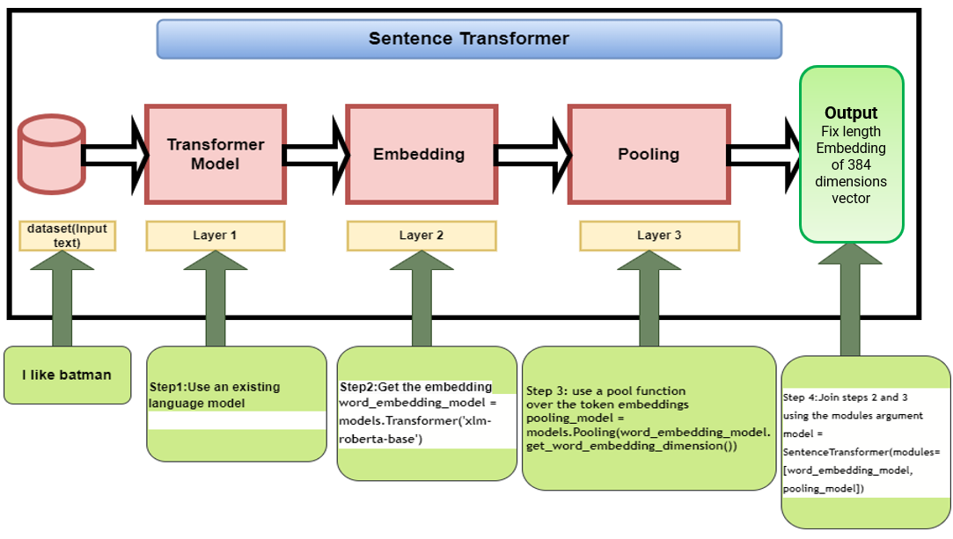
Architecture Diagram
STAT

Slide 8
Advantages of Model
S.no | Advantages | Description
1 | High-Quality Sentence Embeddings | Unlike word embeddings, which represent individual words, sentence transformer models generate meaningful vector representations of entire sentences, capturing context effectively
2 | Efficient Semantic Search & Similarity | Sentence transformers are optimized for computing semantic similarity between sentences, making them ideal for tasks like Document retrieval, Duplicate question détection, Plagiarism détection, Recommandation system.
3 | Faster and More Efficient | Sentence transformers generate fixed embeddings that can be compared efficiently using cosine similarity or Euclidean distance.
4 | Improved Performance on Downstream NLP Tasks | These models enhance performance in applications such as: Text clustering (grouping similar texts together),Topic modeling, Machine translation Summarization (as a preprocessing step)
5 | Supports Various Pre-Trained Models | Sentence transformers provide pre-trained models optimized for different tasks
6 | Scalability with Approximate Nearest Neighbors (ANN) | When dealing with large datasets, sentence embeddings can be indexed and searched efficiently using ANN techniques
7 | Works Well with Low-Resource Languages | Many sentence transformer models support zero-shot learning and multilingual text understanding, making them useful for languages with limited training data.
8 | Supports Few-Shot and Zero-Shot Learning | Some sentence transformer models (like Cross-Encoders) can be fine-tuned for specific NLP tasks with very little labeled data, improving adaptability.
STAT

Slide 9




What did we Achieve?
Personalization and Customer Experience
Efficiency and Improves productivity
Improved Accuracy and Precision
Continuous Learning and Adaptability

Slide 10
Demo

Slide 11
Demo Video
Slides Demo:
URL: https://github.com/ewfx/gaipl-wels-v/blob/main/artifacts/demo
File Name : Hackathon-Slides-Video.mp4
Application Setup and Run Demo:
URL: https://github.com/ewfx/gaipl-wels-v/blob/main/artifacts/demo
File Name: Application setup and Run Demo.mp4

Slide 12
Thank you

